Slide 1
EV3dev with Python

Slide 2
HOW TO SET UP
1/ Format the SD card
2/ Write ev3dev-jessie to the SD card
3/ Plug the SD card into the brick
4/ Access the environment from a third party SSH client
5/ Write a program
6/ Debug from the interactive mode
6/ Run the program from the brick

Slide 3
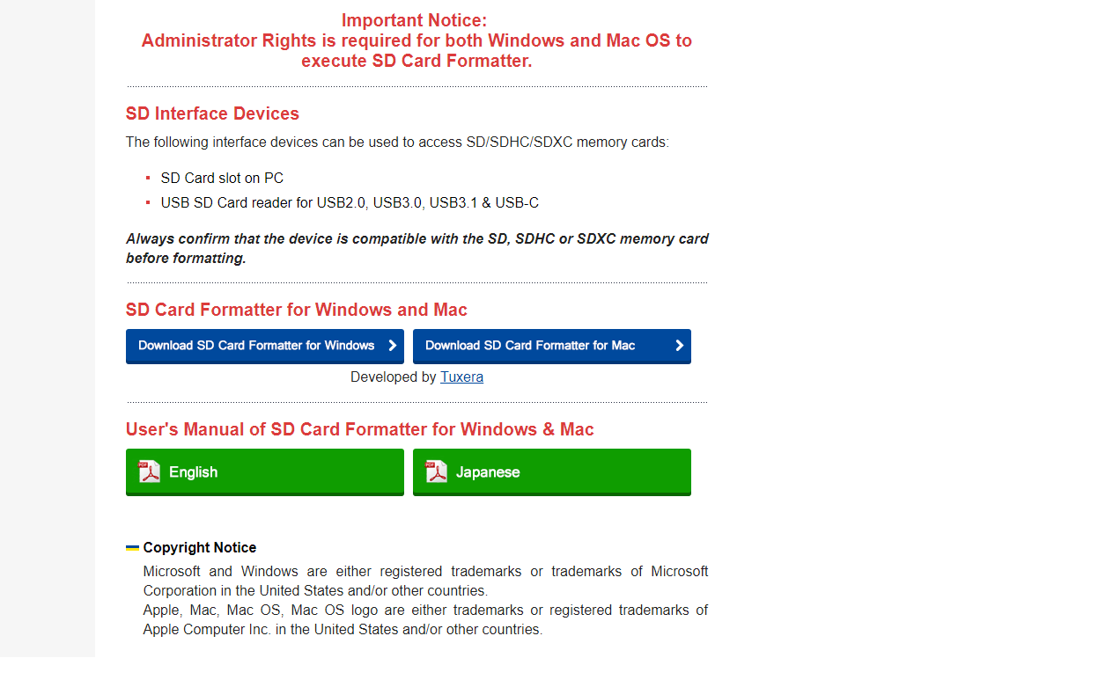
1/ Download SDFormatter
https://www.sdcard.org/downloads/formatter_4/index.html

Slide 4
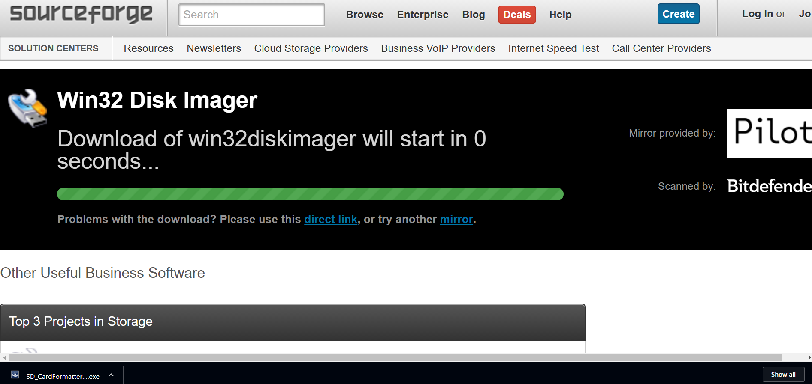
2/ Download Win32DiskImager
https://sourceforge.net/projects/win32diskimager/postdownload?source=dlp

Slide 5
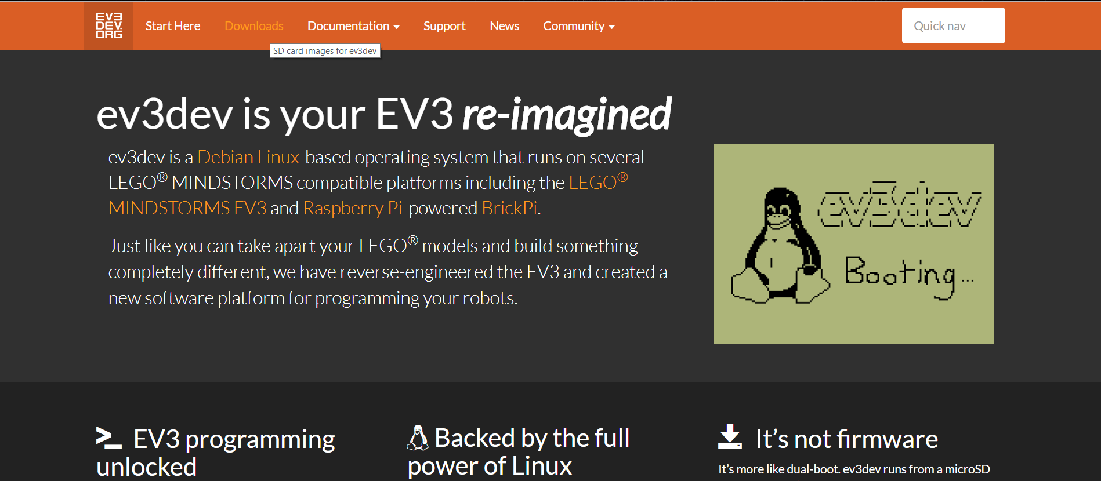
Download the ev3dev Image
http://www.ev3dev.org/downloads/

Slide 6
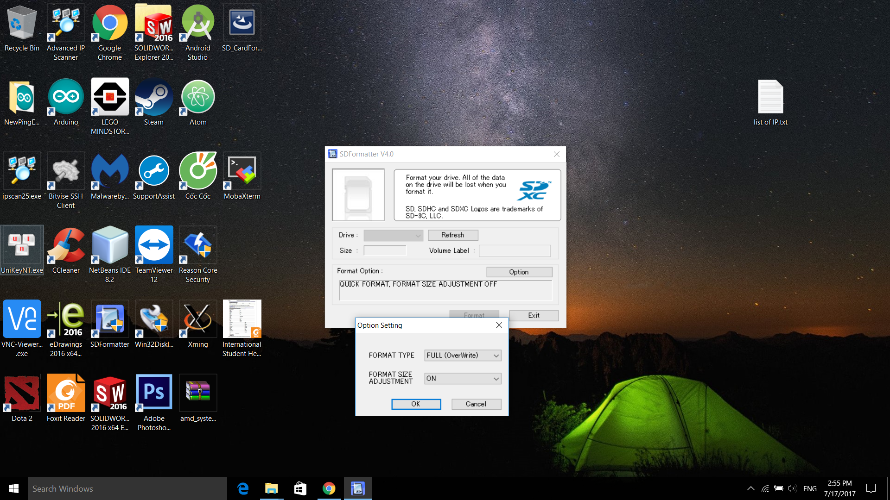
Format the SD card first

Slide 7
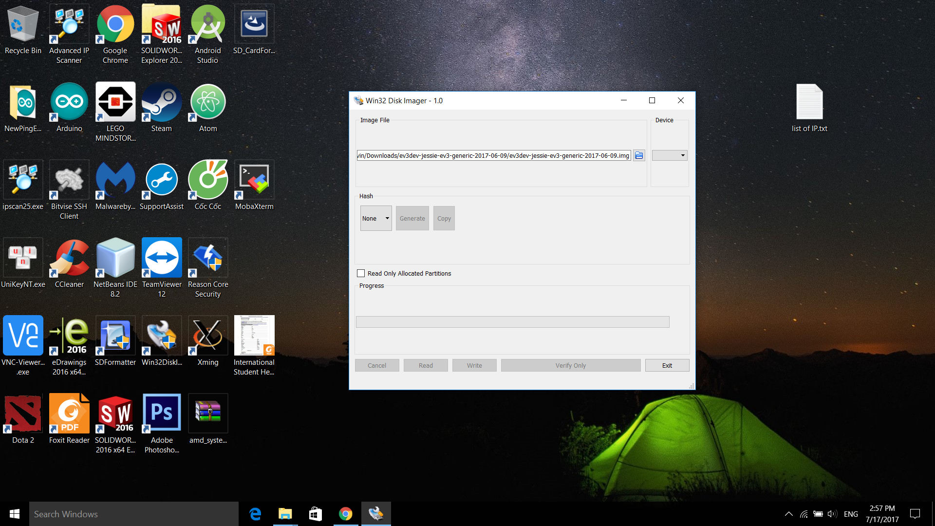
Write EV3dev image to your SD card

Slide 8
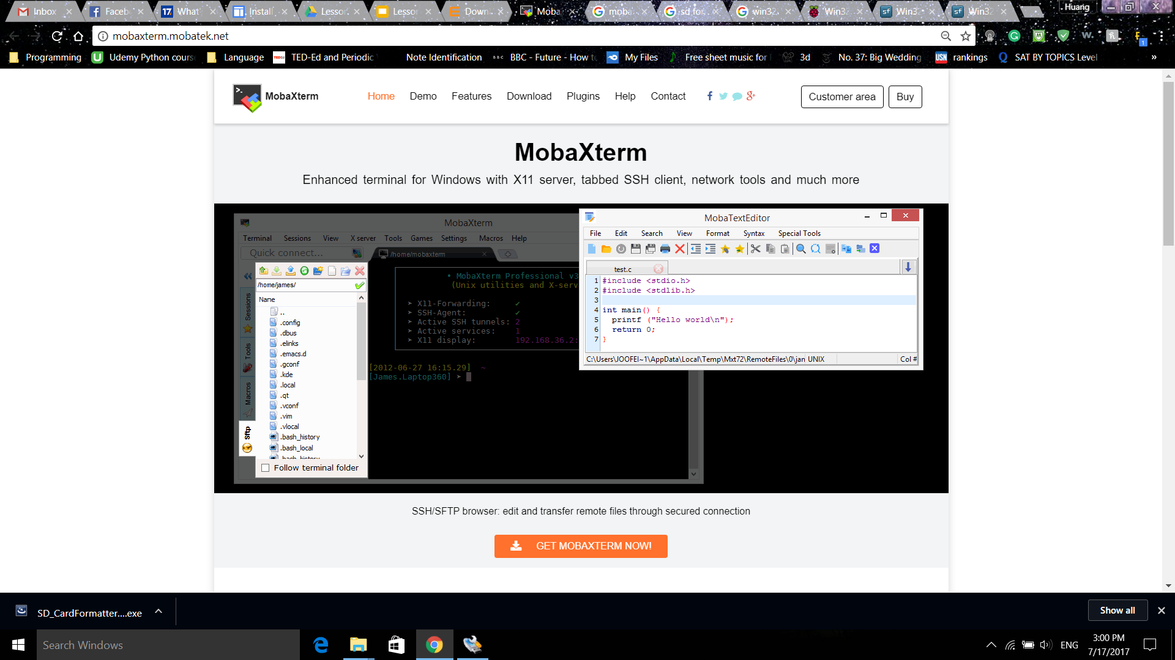
Download MobaXterm

Slide 9
What is MobaXterm?
+MobaXterm provides all the important remote network tools (SSH, X11, RDP, VNC, FTP, MOSH, ...) and Unix commands (bash, ls, cat, sed, grep, awk, rsync, ...) to Windows desktop.
+It is used for remote computing.
+There are similar programs like Putty, Xming…

Slide 10
These following steps are very important after MobaXterm has been installed
Do the following in strict order:
+First, boot the ev3dev from your brick and wait until it has done booting.
+Connect the brick to your laptop
+Wait a minute until the the computer has identified the NDIS connection
+Disable other Ethernet connections (if any)
+Turn on the sharing settings and enable all the services.

Slide 11
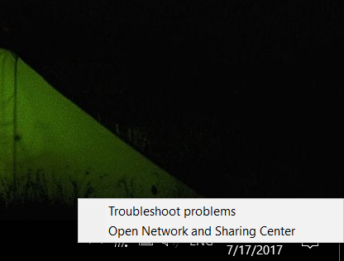
Right click on the Wifi icon and choose Open Network and Sharing center

Slide 12
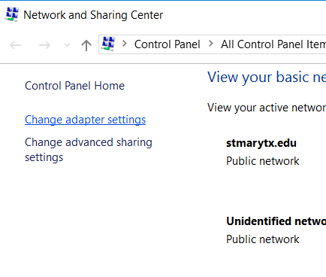
Click on Change adapter settings

Slide 13
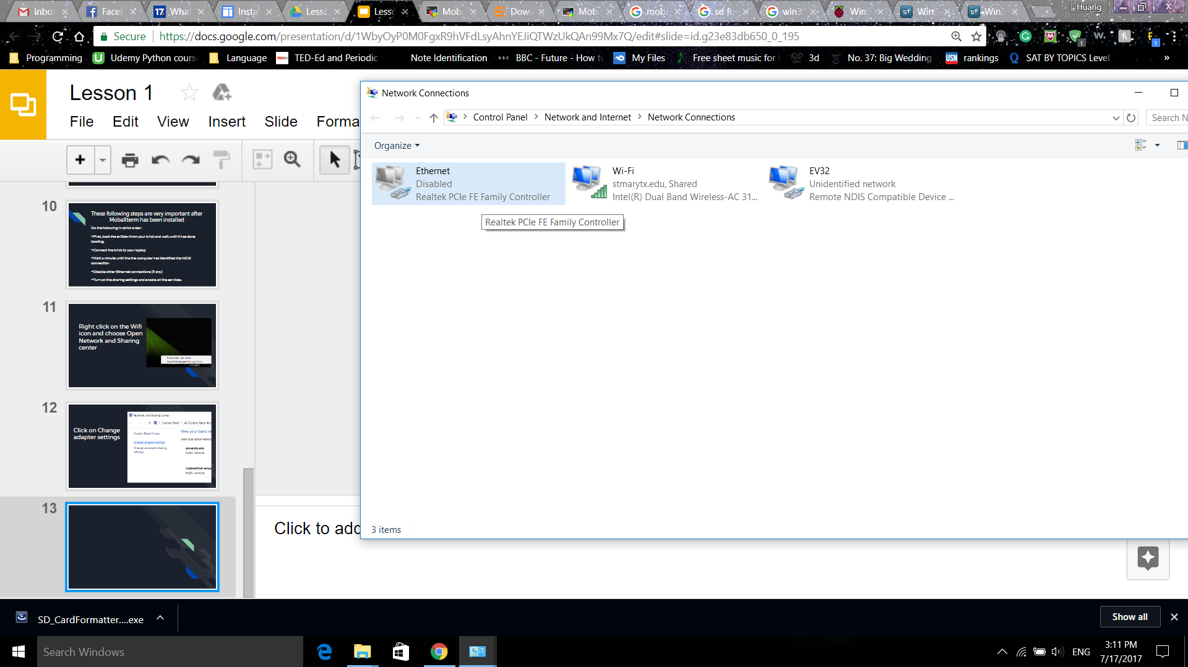
Disable other Ethernet connection and right click on the Wi-Fi. You should see a NDIS connection named Ethernet. Change it to EV3

Slide 14
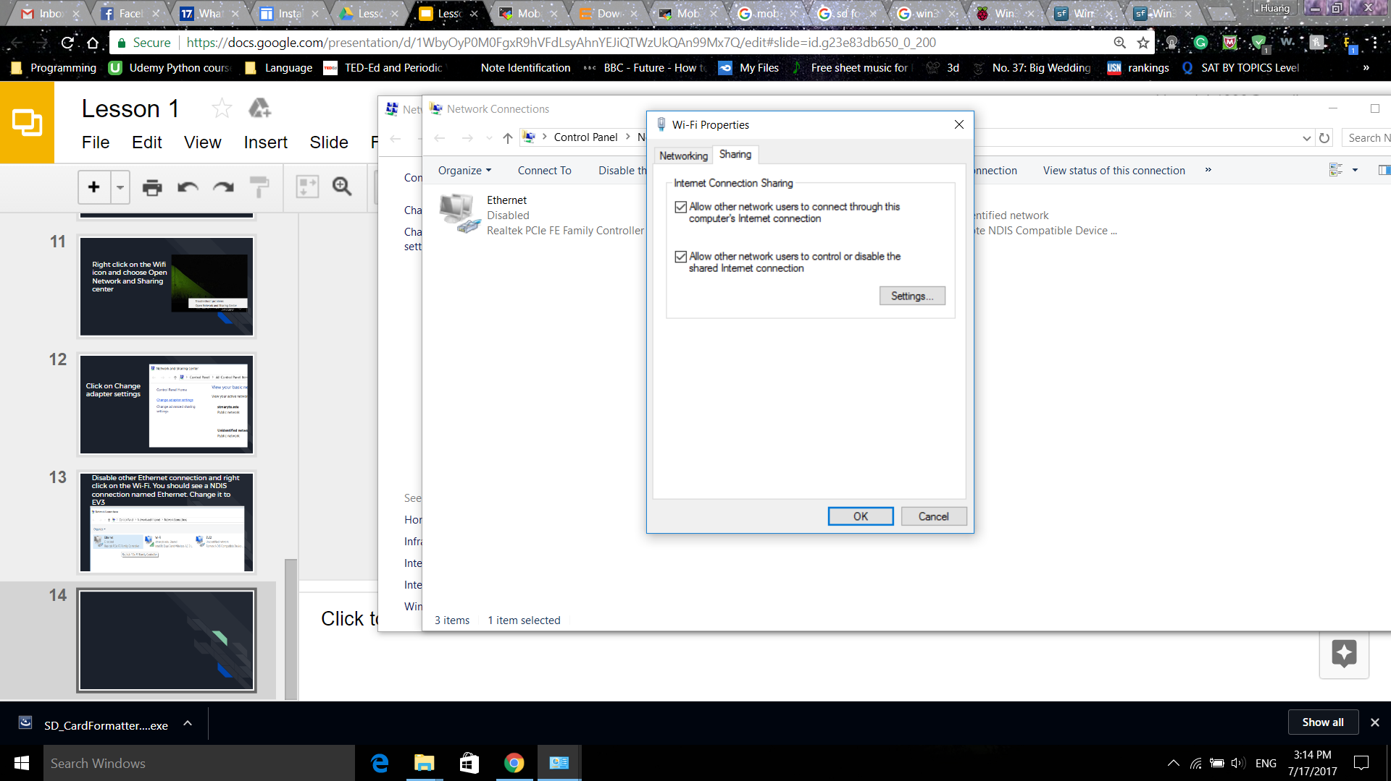
Go to Wi-Fi Properties and Sharing tab. Turn on the Allow other network connections. Click on Settings and enable all other services

Slide 15
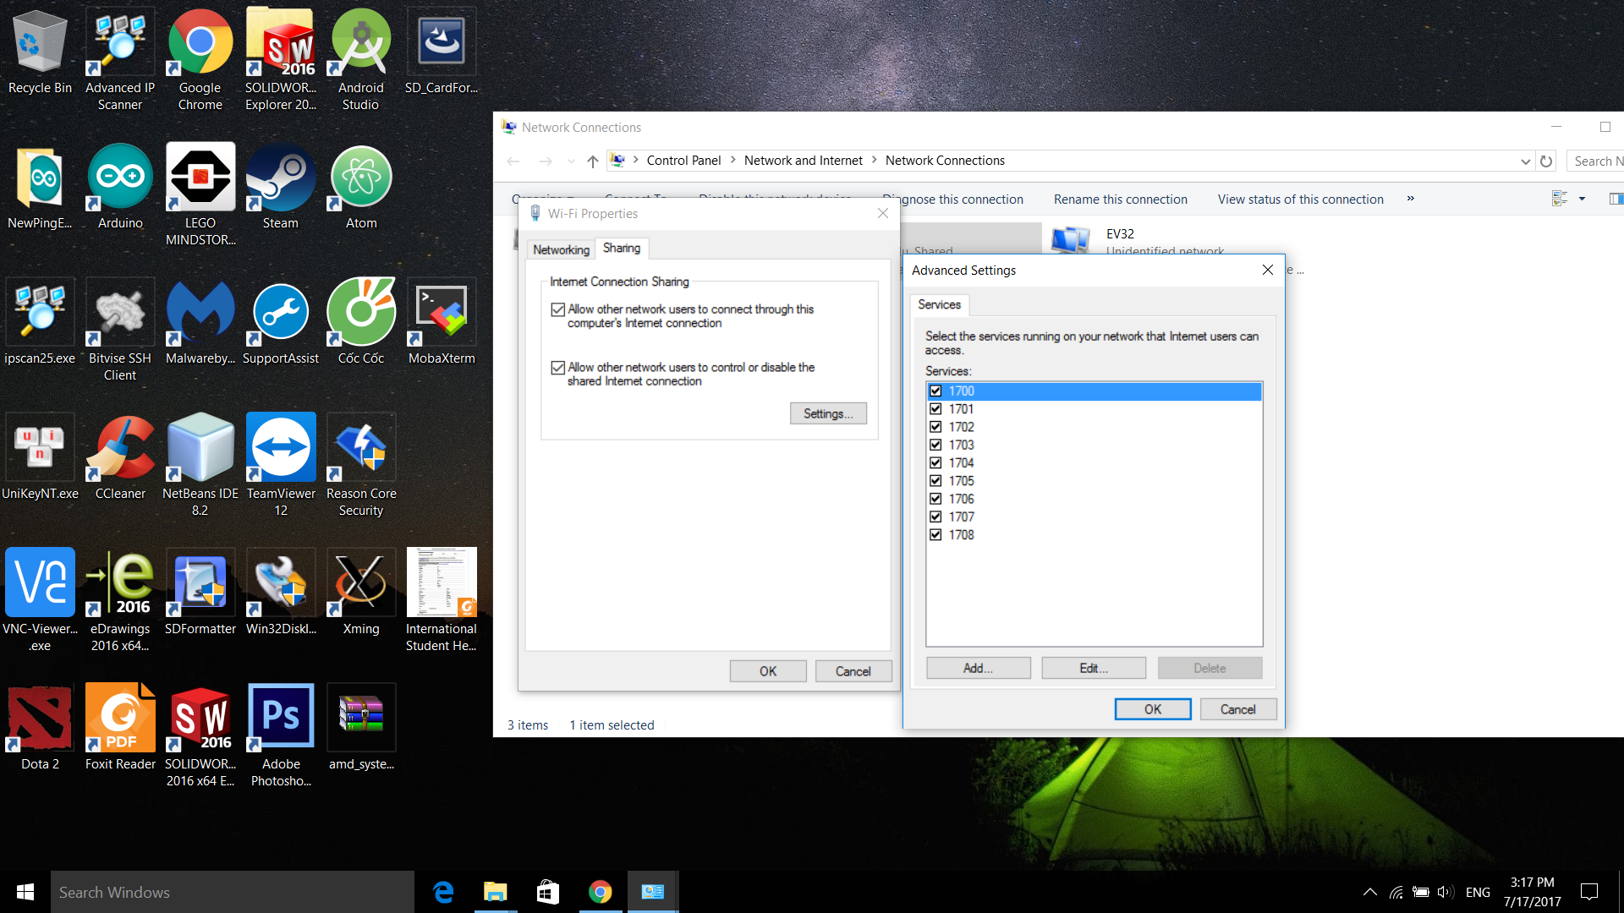
Click ok after enabling all the services

Slide 16
Set up the BRICK
+Go to Wireless and Networks
+Choose ‘All Network connections’
+Click on ’Wired’
+Select ‘IPv4’
+Click Change, then ‘Load Windows defaults’ (if you’re using Windows)
+Go back to Wire. And finally, click ‘Connect’.
+Make sure the IP address is static (unchanged) and it should be: 192.168.137.3.
+You should see ‘State: Connected’

Slide 17
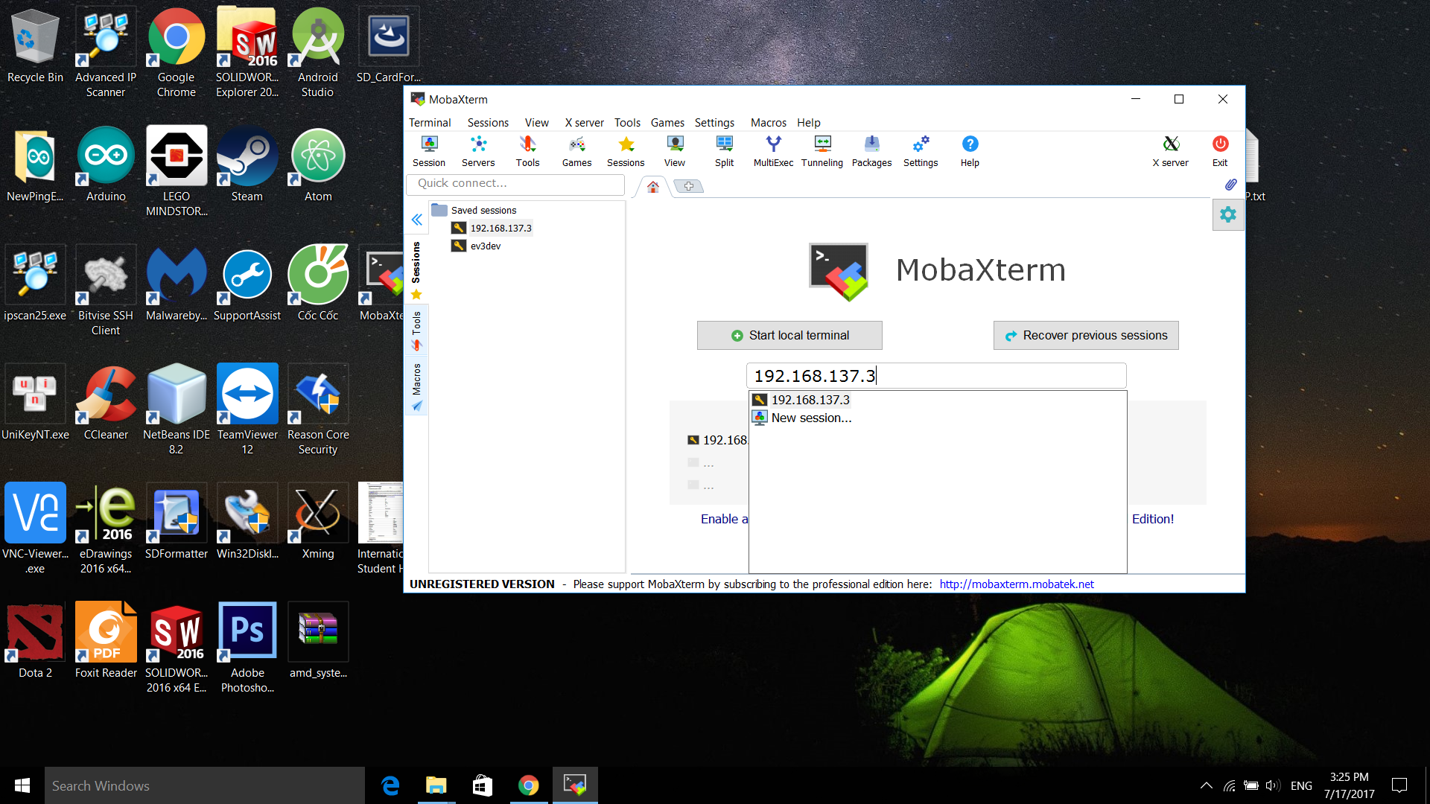
Run MobaXterm and insert the IPv4 address you see on the Brick. Most likely, it will be 192.168.137.3. Click Enter and choose SSH as the connection type (if required)

Slide 18
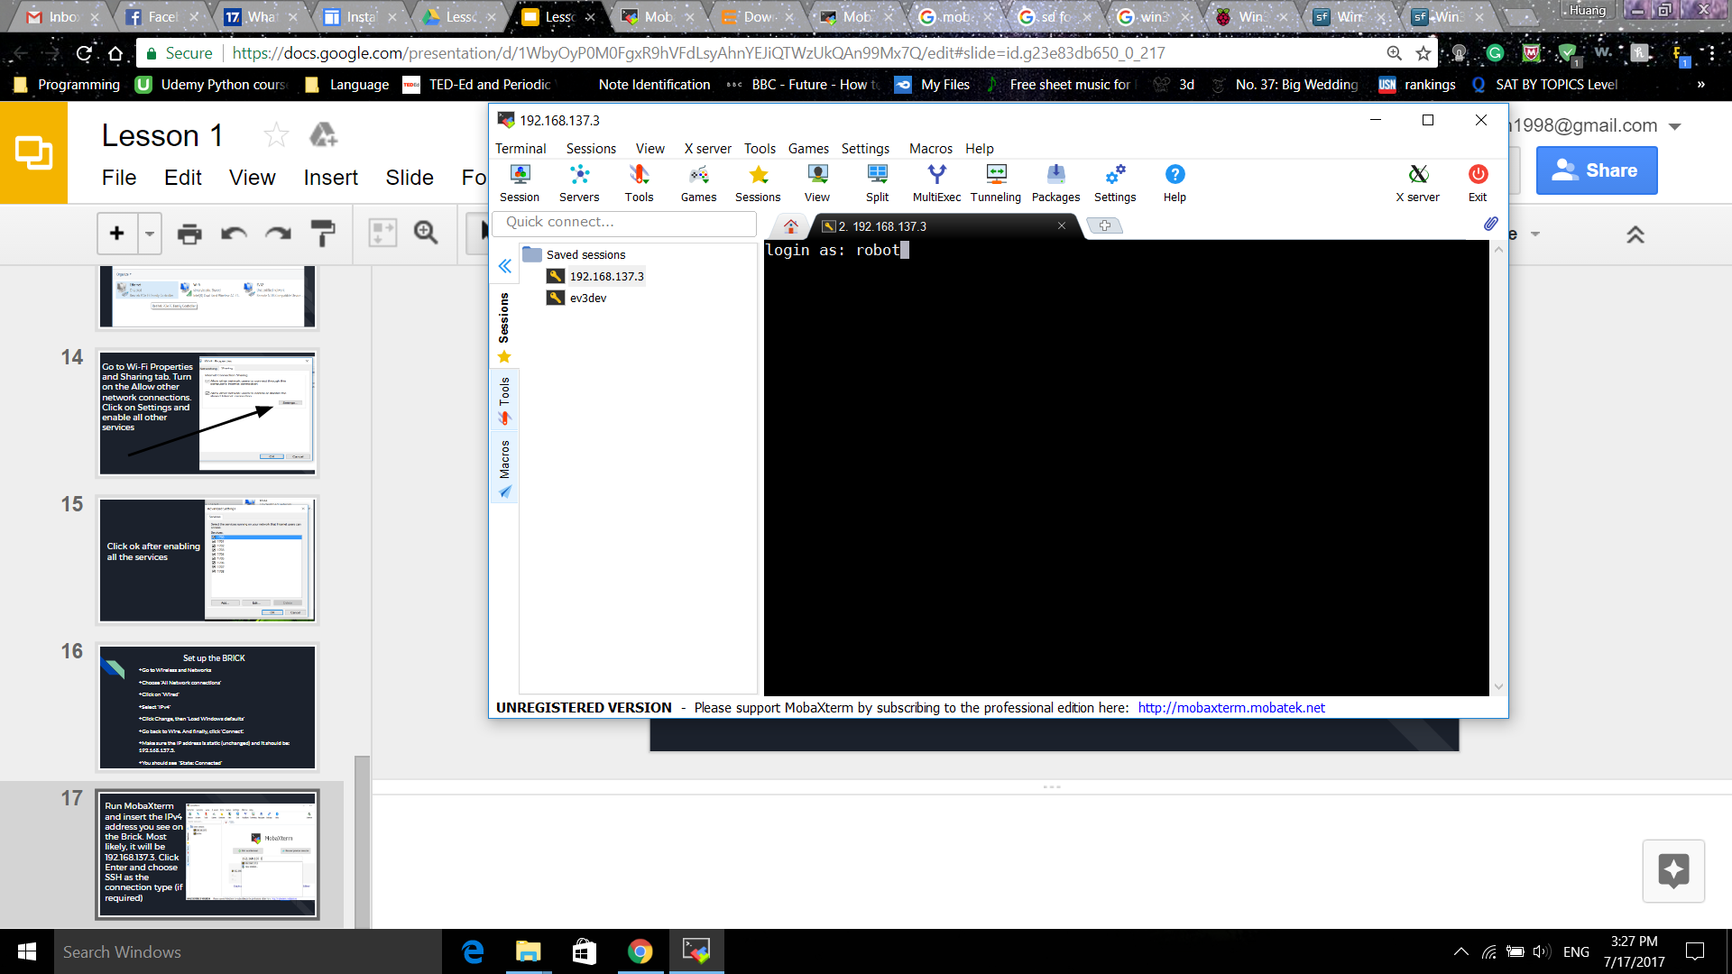
Default login name: robot
Pass: maker

Slide 19
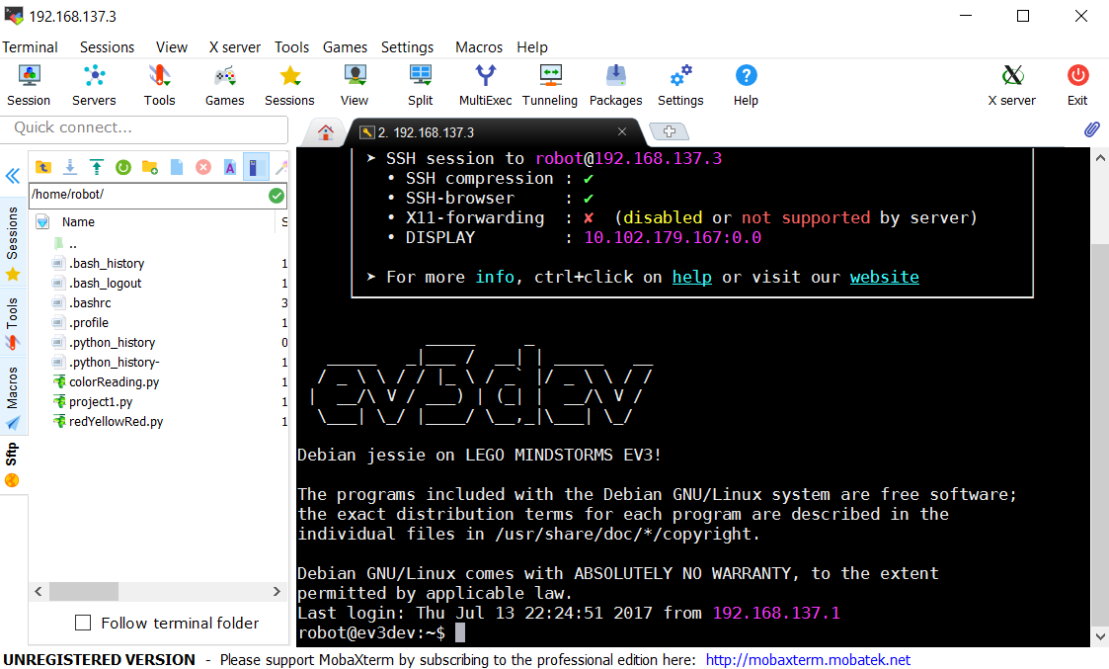
EV3dev interface

Slide 20
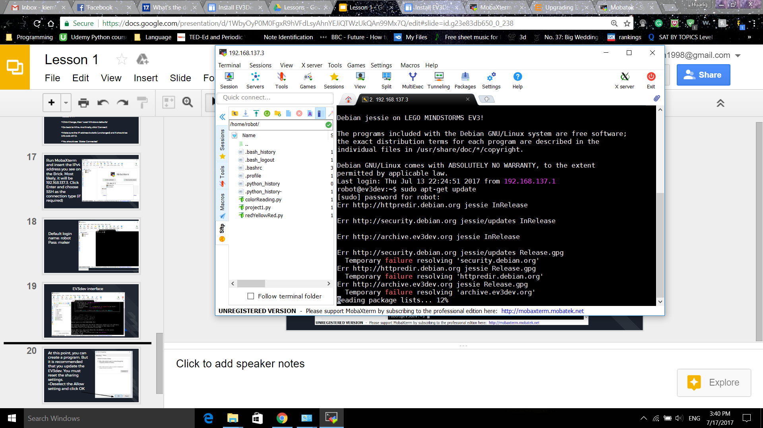
It is optional to update the ev3dev but is highly recommended.
Type ‘sudo apt-get update’
**There will be errors because of a bug from an old brick**

Slide 21
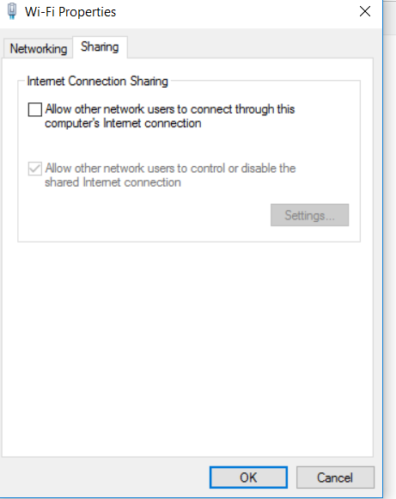
At this point, you can create a program. But for full packages you must update the EV3dev to run from the Brickman. You must reset the sharing settings to download packages.
+Deselect the Allow setting and click OK

Slide 22
Then Enable the Allow setting again and click OK to fully reset

Slide 23
UPDATE EV3DEV
+Log on back to MobaXterm.
+Run the following commands and wait. If prompted for permission, type ‘Y’ to proceed.
+Type ‘sudo apt-get update’ and it should be working at this moment.
+Type ‘sudo apt-get upgrade’ after the update.
+Type ‘sudo apt-get dist-upgrade’.
+Type ‘sudo apt-get install dos2unix
+At the end, type ‘sudo reboot’ to complete.

Slide 24
